Slide 1




Week-4 (Discussion)
19th August, 2024
Introduction to Machine Learning
Prof. Balaraman Ravindran
Professor and Head of the Department
Department of Data Science and Artificial Intelligence
IIT Madras
Ayan Paul
PMRF Research Scholar
IIT Kharagpur

Slide 2
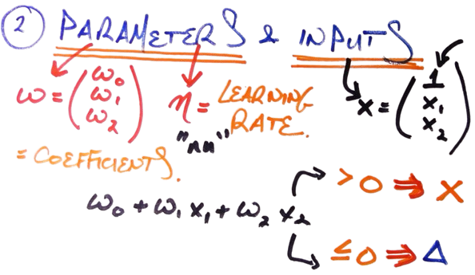
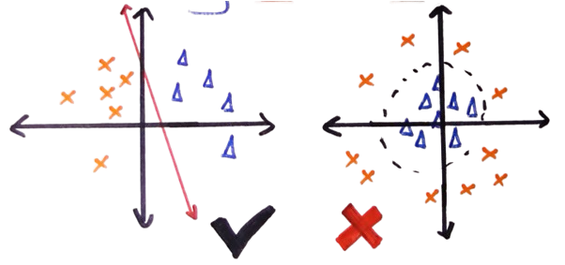
Perceptron Learning Algorithm
Perceptron is a linear supervised machine learning algorithm. It is used for binary classification.
Condition: Data should be linearly separable

Slide 3
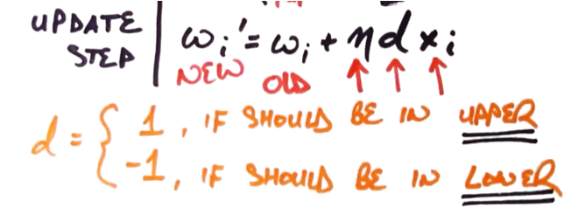
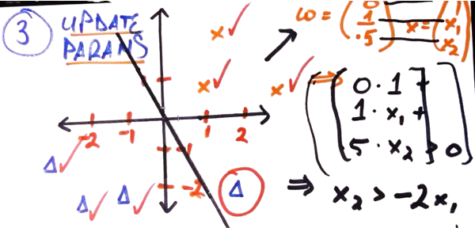
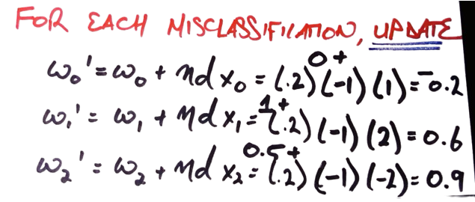
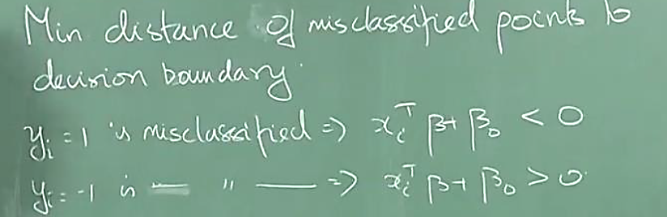
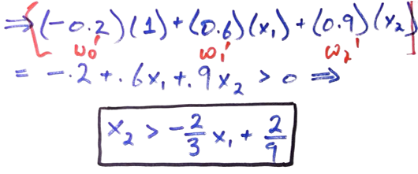
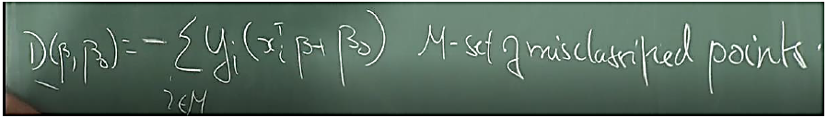

Slide 4
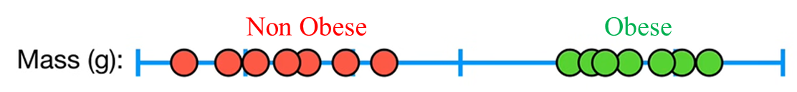
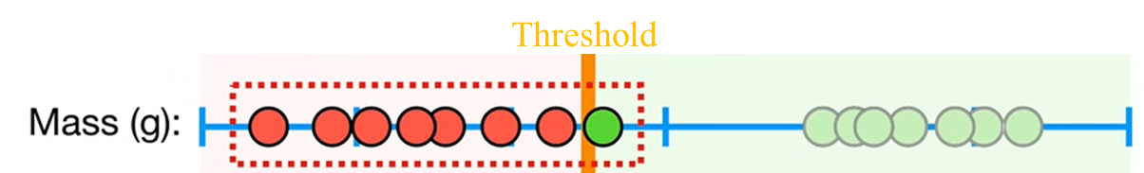
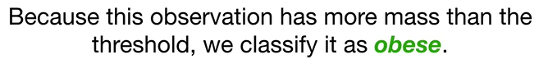
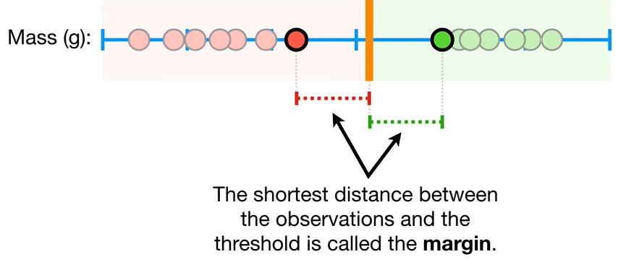
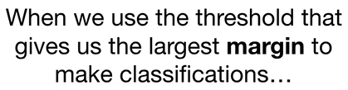
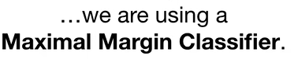
Support Vector Machines
Threshold at midpoint between extremes

Slide 5
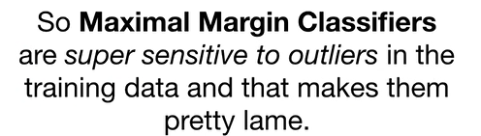
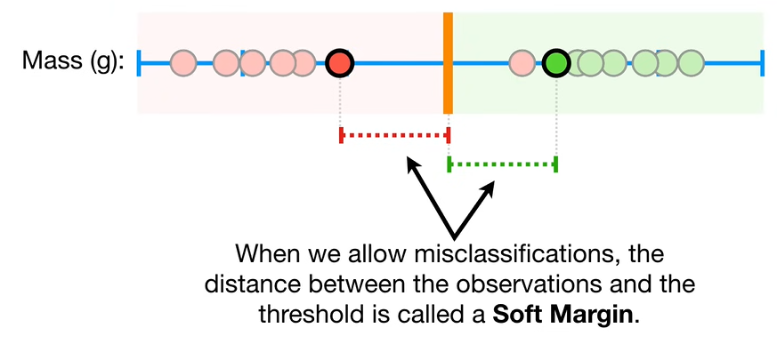
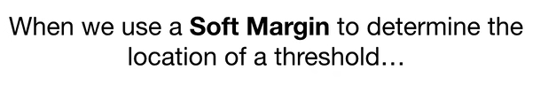
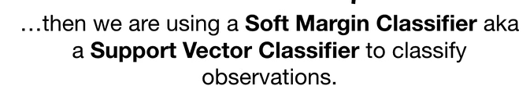
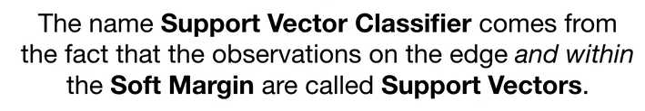
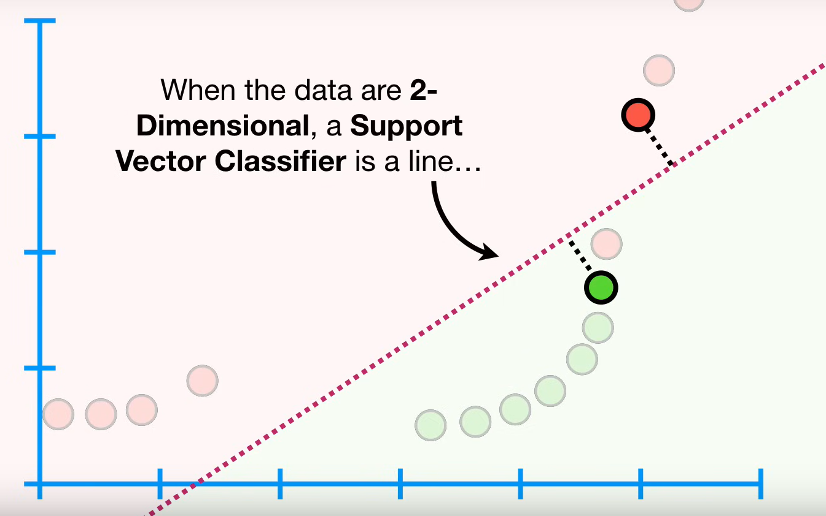
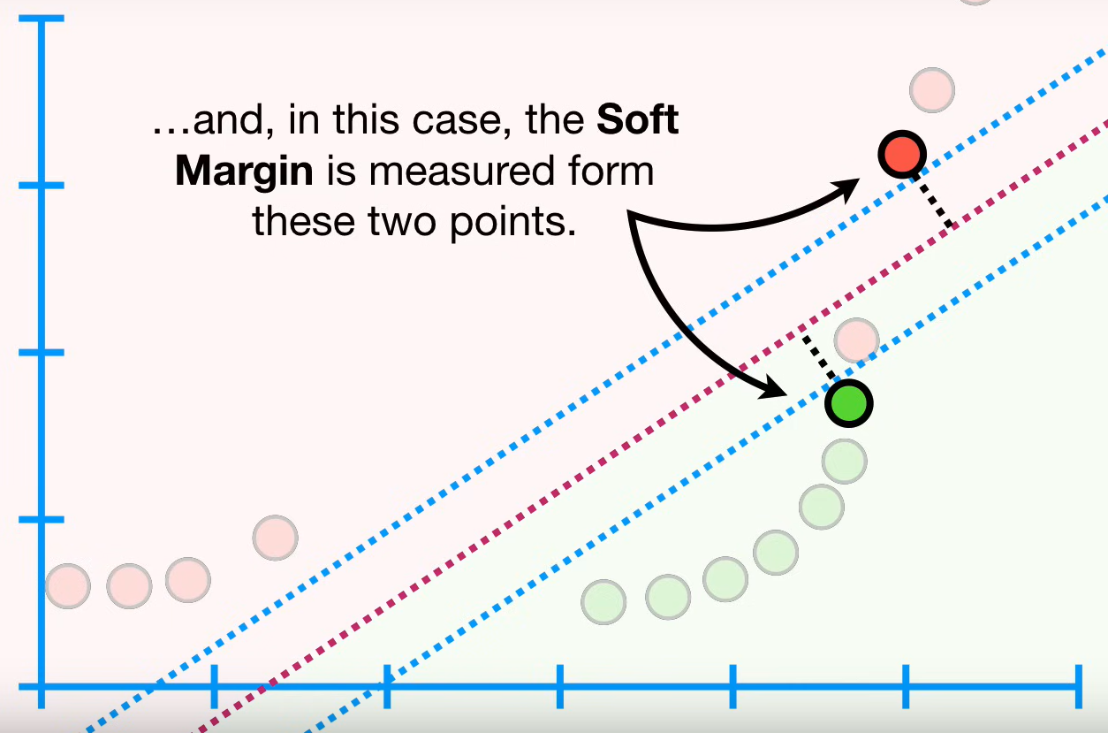
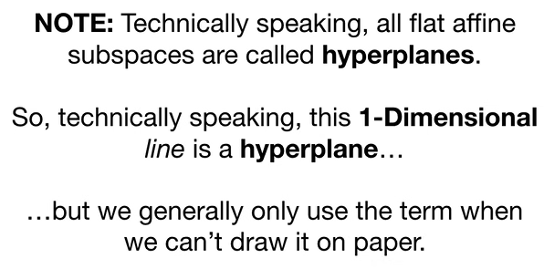

Slide 6
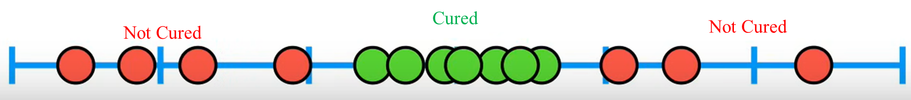
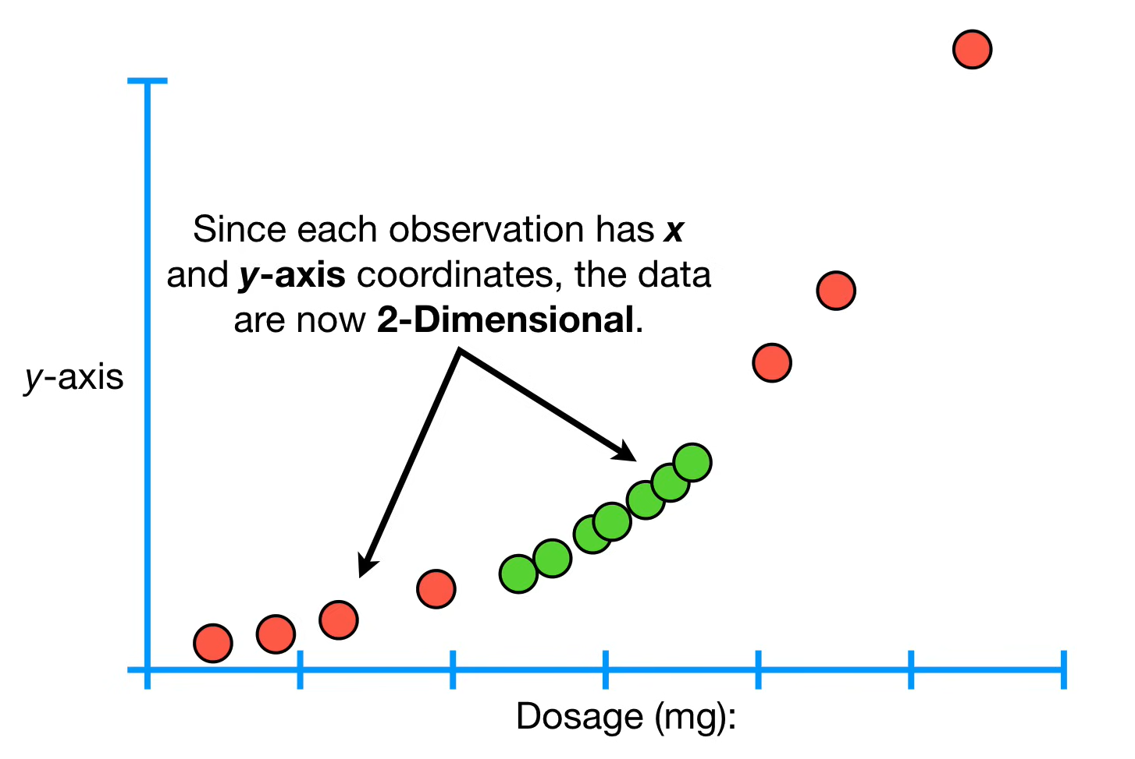
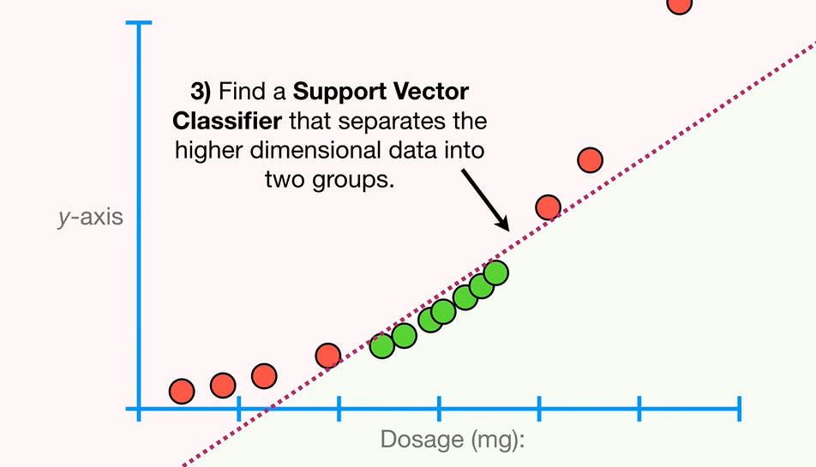
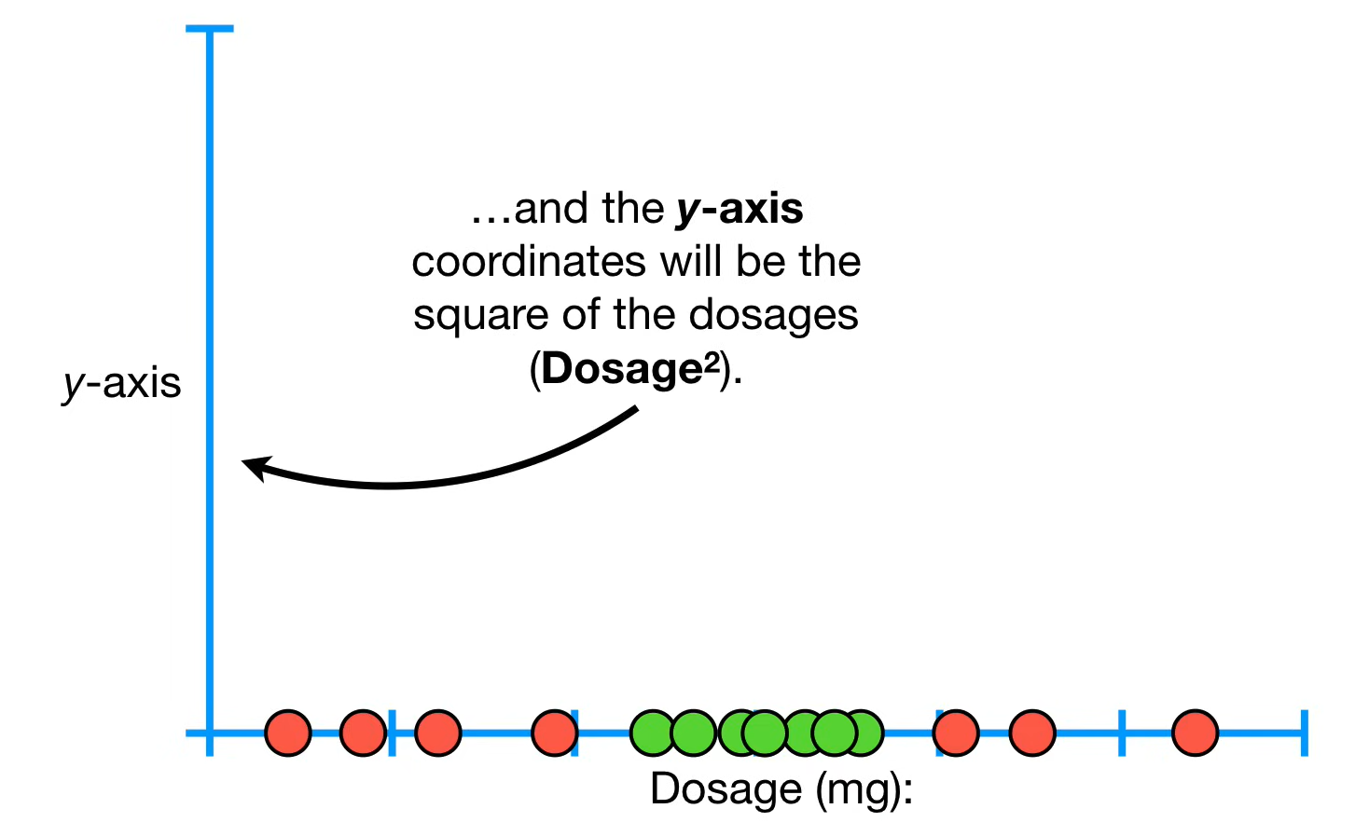
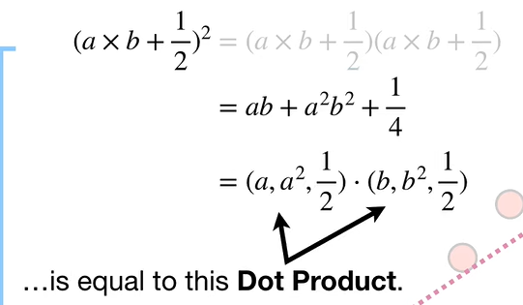
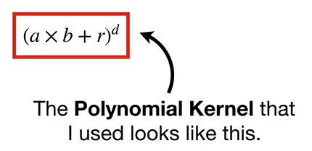
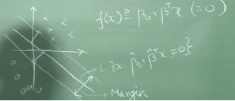
Kernel Concept

Slide 7
Topics on which Week 4 Assignment Questions are based
Perceptron
Support Vector Machines

Slide 8
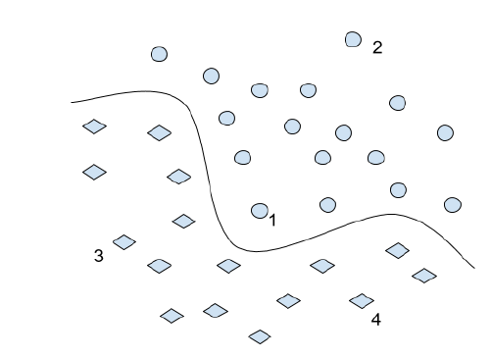
QUESTION 1
For a two-class classification problem, we use an SVM classifier and obtain the following separating hyperplane. We have marked 4 instances of the training data. Identify the point which will have the most impact on the shape of the boundary on its removal.
a) 1
b) 2
c) 3
d) 4
SOLUTION 1
We need to identify support vectors on which the hyperplane is supported. In the figure above, data point 1 is a support vector. Removal of data point 1 will have an impact on the decision boundary.
CORRECT ANSWER 1
a)

Slide 9
QUESTION 2
SVM cannot classify data that is not linearly separable even if we transform it to a higher-dimensional space.
(a) True
(b) False
(c) Cannot be said
SOLUTION 2
SVM can classify data that is not linearly separable if it is transformed to a higher-dimensional space with the help of kernels
CORRECT ANSWER 2
b)

Slide 10
QUESTION 3
Consider a soft-margin SVM with a linear kernel and no slack variables, trained on n points. The number of support vectors returned is k. By adding one extra point to the dataset and retraining the classifier, what is the maximum possible number of support vectors that can be returned (tuning parameter C)?
(a) k
(b) n
(c) n + 1
(d) k + 1
SOLUTION 3
The maximum number of support vectors that can be returned is equal to the number of training points
CORRECT ANSWER 3
c)

Slide 11
QUESTION 4
Consider the data set given below.
Claim: The PLA (Perceptron Learning Algorithm) can learn a classifier that achieves zero misclassification error on the training data. This claim is:
a) True
b) False
c) Depends on the initial weights
d) True, only if we normalize the feature vectors before applying PLA.
Feature 1 | Feature 2 | Class
0 | 0 | A
0 | 1 | B
1 | 0 | B
1 | 1 | A
SOLUTION 4
This dataset is not linearly separable; hence Perceptron Learning Algorithm will not achieve zero misclassification error on the training data.
CORRECT ANSWER 4
b)

Slide 12
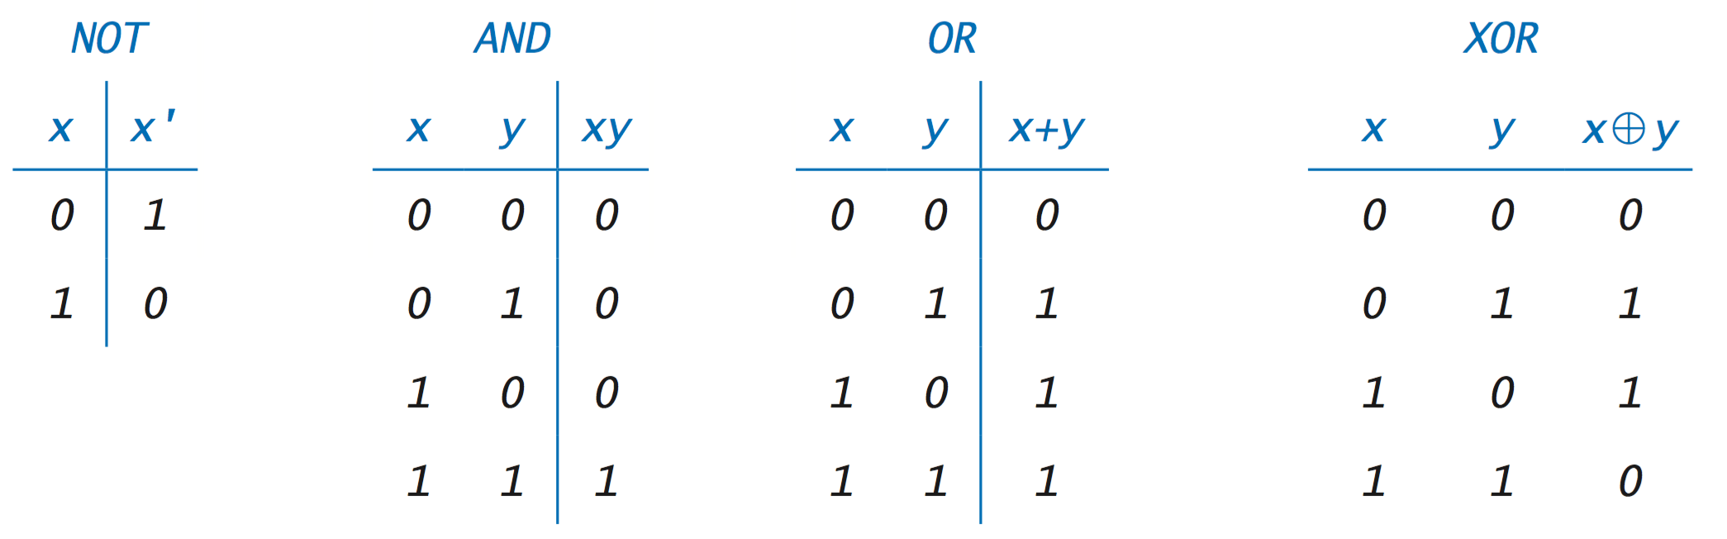
QUESTION 5
Which of the following is/are true about the Perceptron classifier?
a) It can learn a OR function
b) It can learn a AND function
c) The obtained separating hyperplane depends on the order in which the points are presented in the training process.
d) For a linearly separable problem, there exists some initialization of the weights which might lead to non-convergent cases.
SOLUTION 5
OR is a linear function, hence can be learnt by perceptron. XOR is non linear function which cannot be learnt by a perceptron learning algorithm which can learn only linear functions.
The perceptron learning algorithm is dependent on the order on which the data is presented, there are multiple possible hyperplanes, and depending on the order we will converge to any one of them.
We can also prove that the algorithm always converges to a separating hyperplane if it exists. Hence (d) is false.
CORRECT ANSWER 5
a), b), c)

Slide 13
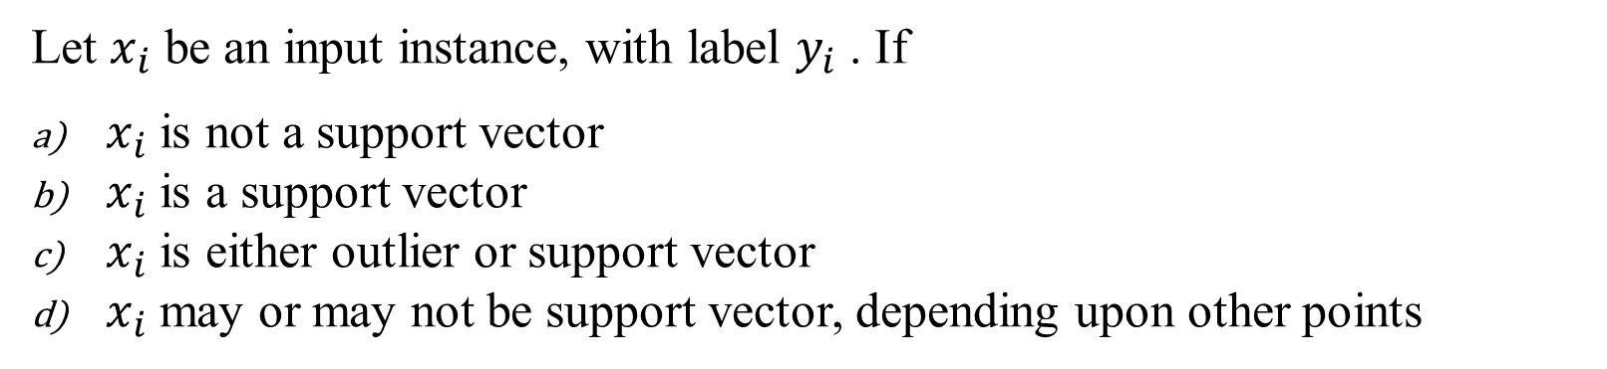
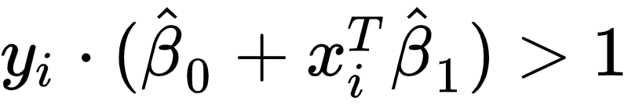
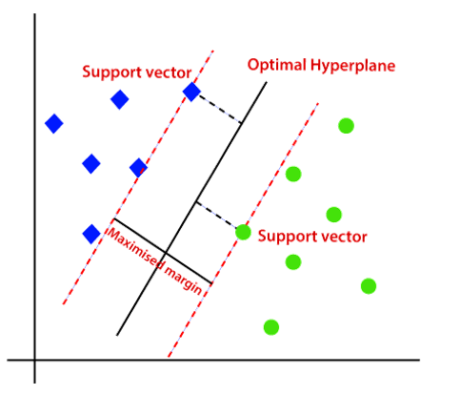
QUESTION 6
SOLUTION 6
CORRECT ANSWER 6
a)

Slide 14
QUESTION 7
Suppose we are using a linear kernel SVM to build a classifier for 2 class problem, where training data points are linearly separable. In general will the classifier trained in this manner will always be same as classifier trained using perceptron algorithm on same training data?
(a) Yes
(b) No
(c) Cannot be said
SOLUTION 7
The hyperplane returned by SVM approach will have a maximal margin whereas no such guarantee can be given for hyperplane identified using perceptron algorithm.
CORRECT ANSWER 7
b)

Slide 15
QUESTION 8
Suppose you have trained an SVM which is not performing well, and hence you have constructed more features from existing features for the model. Which of the following statements may be true?
(a) We are lowering the bias.
(b) We are lowering the variance.
(c) We are increasing the bias.
(d) We are increasing the variance.
SOLUTION 8
When the complexity of the model increases then we are
lowering the bias.
increasing the variance
CORRECT ANSWER 8
a), d)

Slide 16
QUESTION 9
Which of the following is/are true regarding an SVM?
For two dimensional data points, the separating hyperplane learnt by a linear SVM will be a straight line.
In theory, a Gaussian kernel SVM can model any complex separating hyperplane.
Overfitting in an SVM is a function of number of support vectors.
If number of features increases model will less overfit
SOLUTION 9
For two dimensional data points, the separating hyperplane learnt by a linear SVM will be a straight line. (n dimensional data : n-1 dimensional hyperplane)
In theory, a Gaussian kernel SVM can model any complex separating hyperplane. ( Kernel is used in these cases)
Overfitting in an SVM is a function of number of support vectors
CORRECT ANSWER 9
a), b), c)

Slide 17
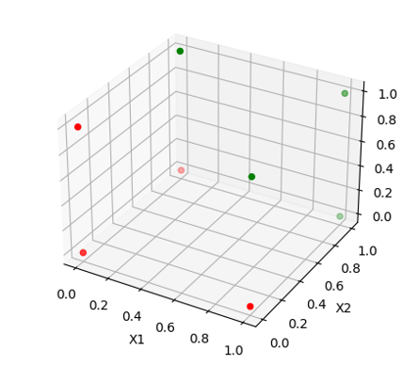
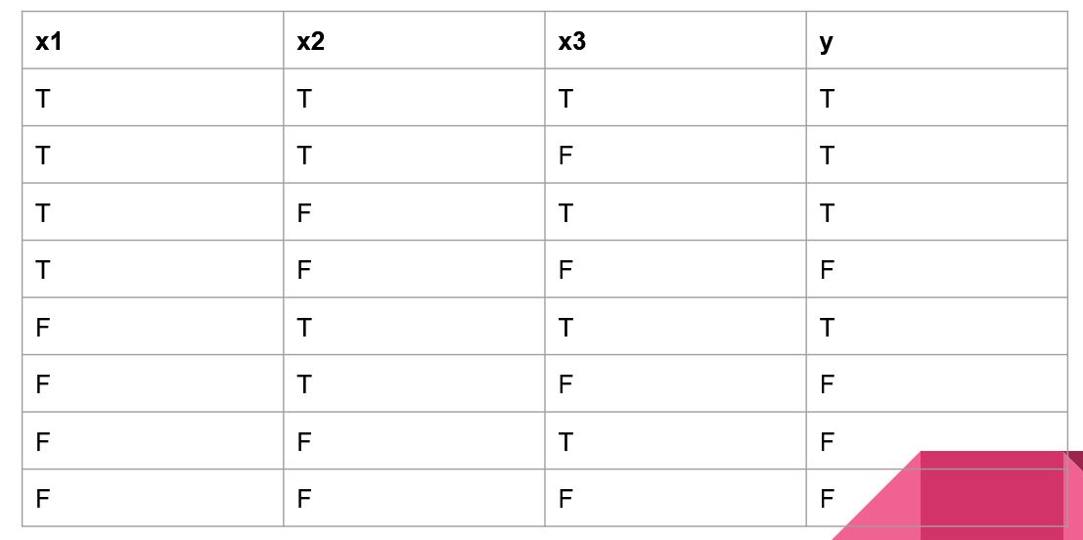
QUESTION 10
Consider a boolean function in three variables. It returns True if two or more variables are True. False otherwise. Can this function be implemented with perceptron algorithm?
a) Yes
b) No
c) Cannot be said
SOLUTION 10
CORRECT ANSWER 10
b)

